Slide 1

UNIVERSITY OF MESSINA
Department
Cognitive Science and Theory of Communication – LM-55
Course Title
SOCIAL SEMIOTICS
Teacher
Maria Rita Bartolomei
Mail: mabartolomei@unime.it

Slide 2

SOCIAL SEMIOTICS
MODERN SLAVERY
HUMAN TRAFFICKING IN THE GLOBAL ERA
Human trafficking
the most serious, pervasive, profitable and emblematic deviant
phenomenon of our times
comes in many shapes and sizes, harming adults and children
in rich and poor countries alike

Slide 3
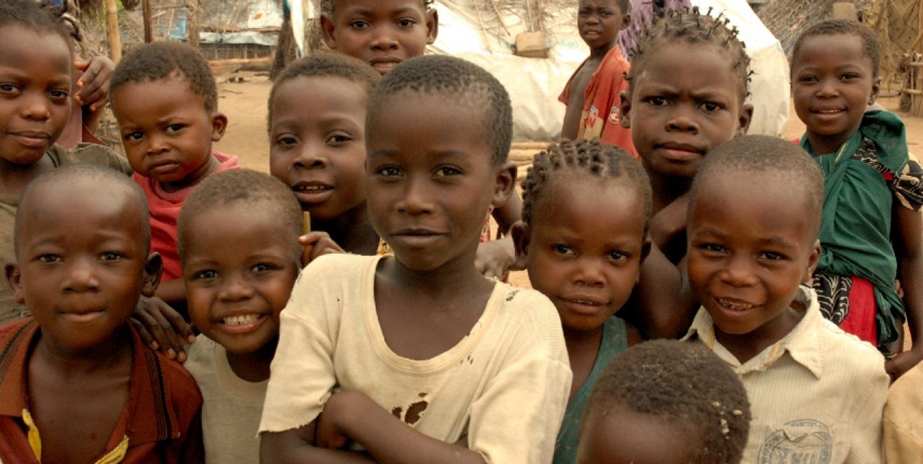
SOCIAL SEMIOTICS
Trafficking and exploitation of children in the global era

Slide 4

SOCIAL SEMIOTICS
What is human trafficking?
It is a transnational crime
It involves the recruitment, transportation, forced transfer, harbouring or receipt of people by means of threat or use of force or other forms of coercion, abduction, fraud, deception, abuse of power, position of vulnerability, giving or receiving payments or benefits to achieve the consent of a person having control over another person for the purpose of economic exploitation

Slide 5
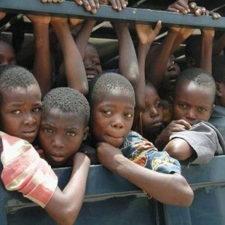
SOCIAL SEMIOTICS
f
sexual exploitation
forced labour or servitude
slavery or practices similar to slavery
forced organ removal
forced crime
forced marriage
illegal adoption
begging
forced or compulsory recruitment of children soldiers

Slide 6

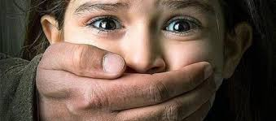
SOCIAL SEMIOTICS
The complexity and nature of this phenomenon make it extremely
difficult to provide accurate data on victims of trafficking globally
The reported or identified cases represent a small part of the reality
Without knowing it, we may meet victims of trafficking in camps, in restaurants, on the streets - beggars and prostitutes - or even in our homes…

Slide 7
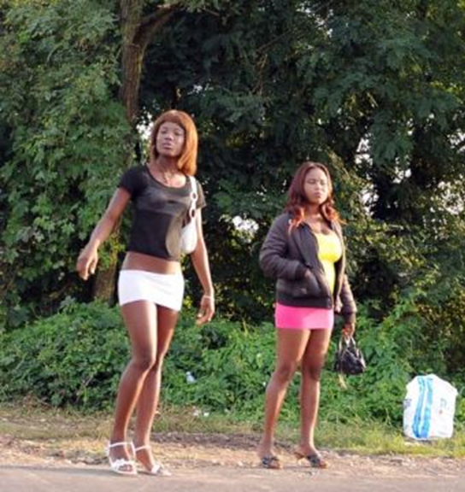
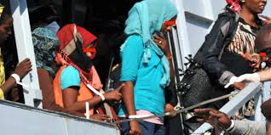
SOCIAL SEMIOTICS
Human trafficking is a serious crime
(Resolution of the European Parliament 1996)
Trafficking thrives, diversifies and transforms
- to adapt to the needs of the markets
- to evade law enforcement actions

Slide 8
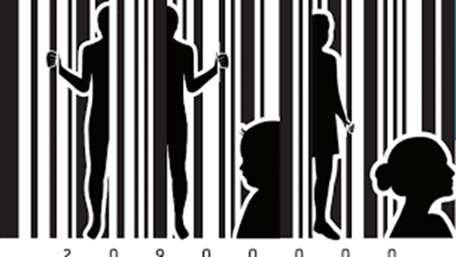
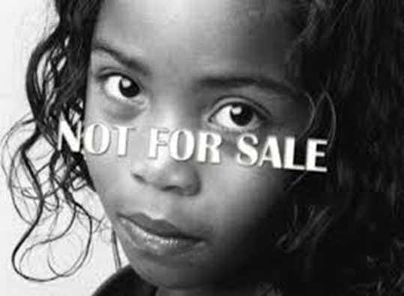
SOCIAL SEMIOTICS
A REPRESSIVE response – Legal aspects
A HUMANITARIAN (human rights) orientation – Protection of victims
A SOCIO-ECONOMIC approach – Structural interventions

Slide 9
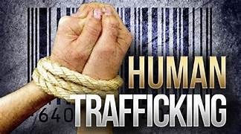
SOCIAL SEMIOTICS
The criminal contrast
Legal aspects
The international community has gained awareness
It intervened by issuing a specific regulation
Humanitarian organisations
Global and integrated setting – (Directive 2011/36/EU)
prevention - repression - protection - social reintegration
GRETA Report 2017 (Council of Europe)
IOM Report 2017

Slide 10
SOCIAL SEMIOTICS
Difference between trafficking and smuggling of people
Human smuggling is a crime against the State
illegal movement and entry into another country or state
violation of one or more countries' laws
Smuggled people are generally willing to be transported

Slide 11
SOCIAL SEMIOTICS
Trafficking in human beings is a crime against the person
it can also include moving, legally or illegally, within a country or
across international borders
it is carried out without consent – or without informed and valid
consent – and for the purpose of exploitation
smuggled people are sometimes vulnerable to becoming trafficked,
during or after travelling
(Palermo Protocol 2000; Directive 2011/36/EU)

Slide 12
SOCIAL SEMIOTICS
The constitutive elements which characterise the legal paradigm, the case in point
The ACT – accomplished by the organisers; what is done for trafficking to occur: recruitment, transport, transfer, etc.;
The MEANS – used to achieve it: deception, threat, use of force, abuse of power, etc.;
The PURPOSE – exploitation
In the case of minors, the medium used is irrelevant
as minors cannot provide valid consent, removal from the community and use in exploitative activities is sufficient
(Art. 3, Palermo Protocol 2002; Warsaw Convention 2005)

Slide 13
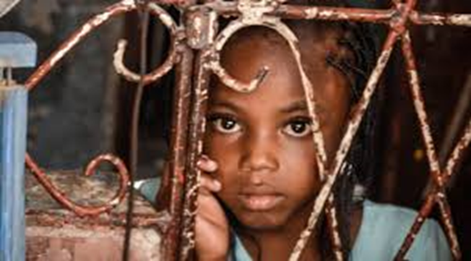
SOCIAL SEMIOTICS
In the case of minors
the medium used is irrelevant, as minors cannot provide valid consent
removal from the community and use in exploitative activities
is sufficient

Slide 14
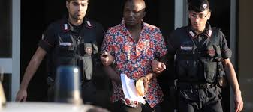
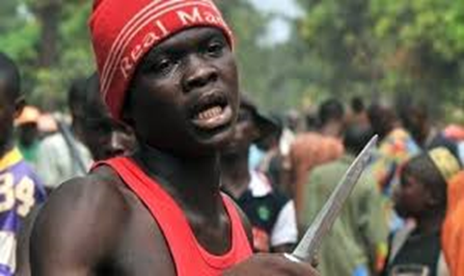
SOCIAL SEMIOTICS
Traffickers are all those who
recruit, transport and control trafficked people
observe them under conditions of exploitation
are involved in related crimes
benefit directly or indirectly: from trafficking,
from the acts which form the case in point
and from the related crimes

Slide 15
SOCIAL SEMIOTICS
Traffickers
are affiliated with international criminal organisations
with the promise of better prospects of work and life
connect their unsuspecting victims with actual networks
of exploitation
use the Internet to recruit victims and accomplices

Slide 16
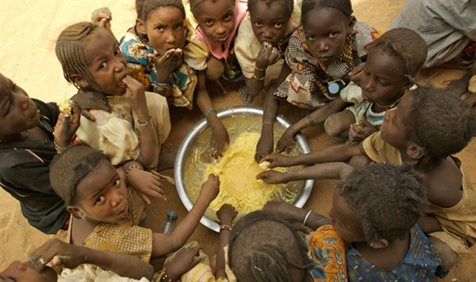
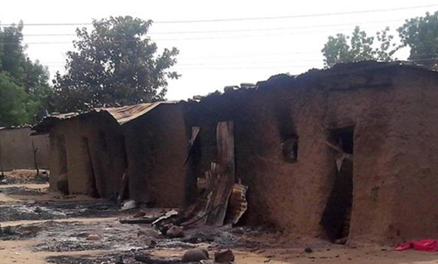
SOCIAL SEMIOTICS
Who are the victims of trafficking?
it is difficult to outline the precise profile of a victim of trafficking
the poorest and most marginalised sections of the world population
who live in conditions of absolute degradation, extreme vulnerability,
ignorance and, often, total desperation

Slide 17
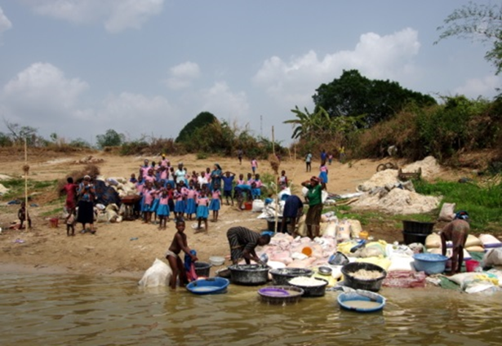
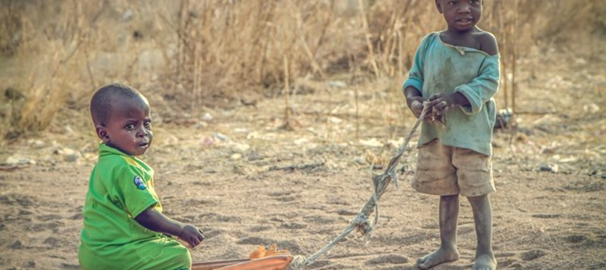
SOCIAL SEMIOTICS
A social semiotics approach
Contextualisation
Understanding of cultural meanings and reasons

Slide 18

SOCIAL SEMIOTICS
Trafficking is both a local and a global phenomenon
Anyone can be a victim of human trafficking, regardless of race, colour, nationality, disability, religion, age, gender, sexual orientation

Slide 19
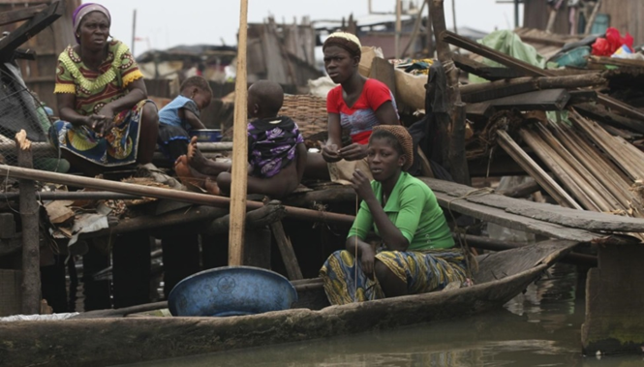
SOCIAL SEMIOTICS
It is a local phenomenon
Connected to the structural conditions of both the contexts of origin
and of arrival

Slide 20
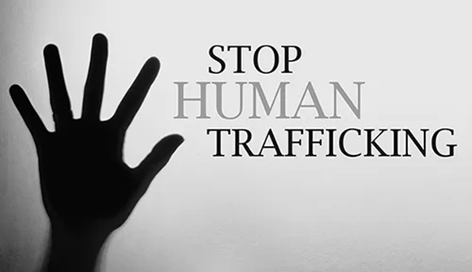
SOCIAL SEMIOTICS
It is a global phenomenon
it involves more and more people
it implies the existence of interconnected transnational criminal circuits which spread in a capillary way over the most disparate territories
operating methods change to remain unpunished

Slide 21
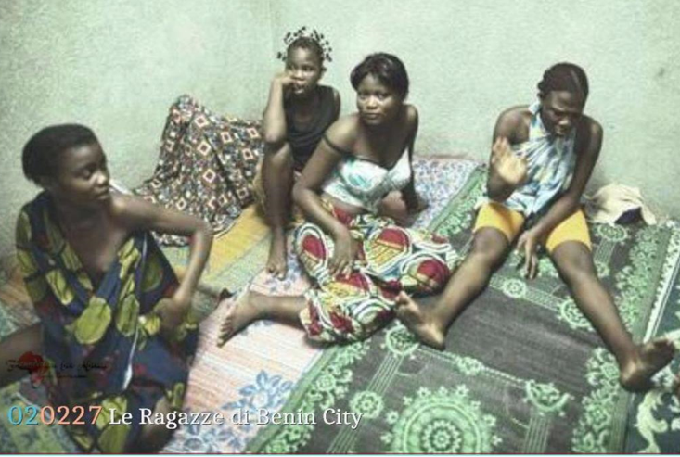
SOCIAL SEMIOTICS
TRAFFICKING
involves men, women or children without distinction
is an underground crime: it is rarely reported
constitutes a serious violation of fundamental human rights
No one shall be held in slavery or servitude; slavery and the slave trade shall
be prohibited in all their forms (Art. 4 UDHR United Nations General Assembly, 1948)

Slide 22
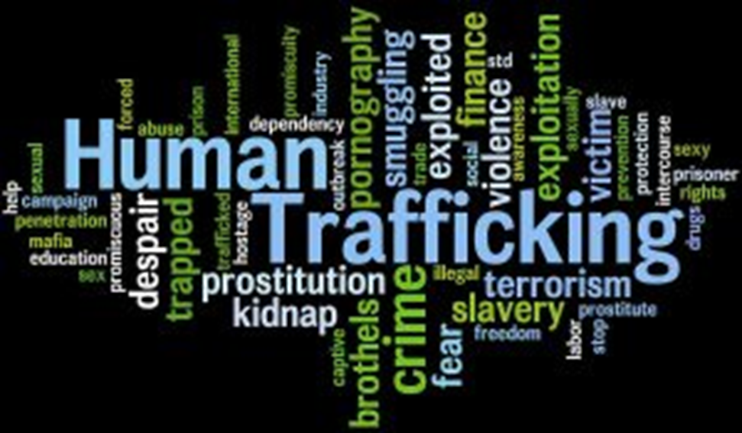
SOCIAL SEMIOTICS

